Slide 1

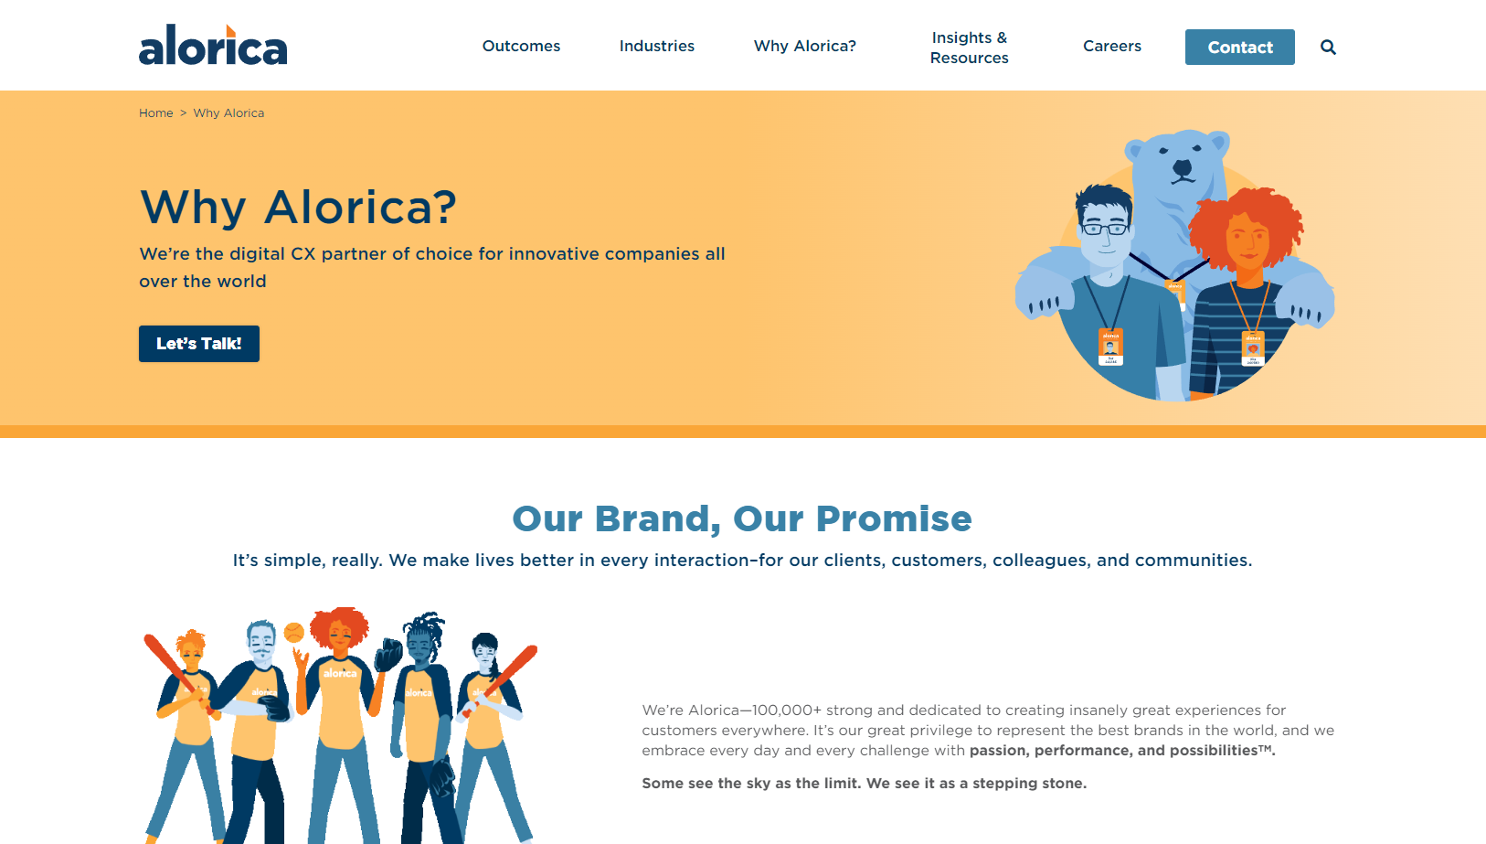
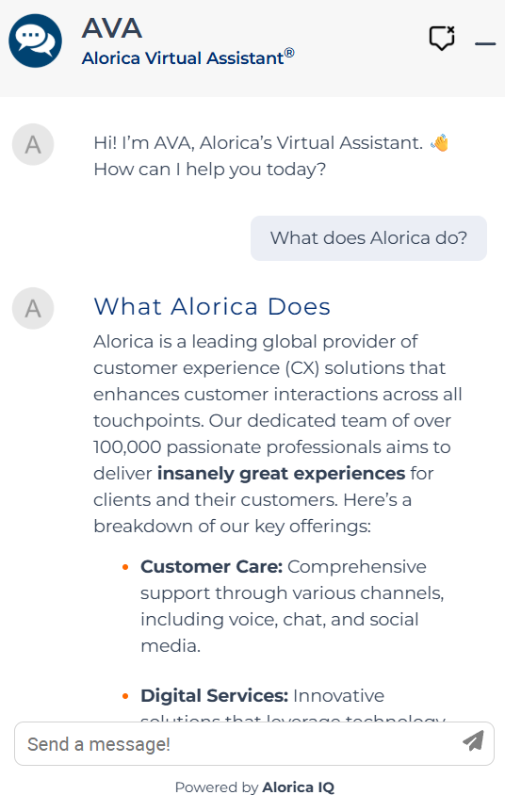
Alorica – Website Migration
Business Need
Alorica, a global business process outsourcing provider, needed to modernize its public website to better reflect its brand, support global marketing efforts, and improve lead generation. The existing platform limited flexibility, scalability, and content management efficiency, making it difficult to support evolving business needs. Alorica also wanted to explore innovative ways to enhance user engagement and provide faster access to information for prospective customers through AI-driven experiences.
What We Did
Led the full redesign and redevelopment of Alorica.com with a modern, scalable architecture
Migrated the website to a cloud-based enterprise CMS to improve performance, security, and content management
Implemented a flexible component and template system to support global marketing teams and regional content needs
Integrated an Agentic AI chatbot to assist visitors with navigation, service discovery, and common inquiries
Ensured the solution supported scalability, accessibility standards, and enterprise security requirements
Results
Delivered a modern, high-performing website aligned to Alorica’s global brand and growth strategy
Improved content authoring efficiency and scalability through a cloud-based CMS platform
Enhanced user engagement by providing faster, AI-assisted access to relevant information
Established a future-ready digital foundation that supports ongoing innovation, personalization, and AI-driven enhancements

Slide 2

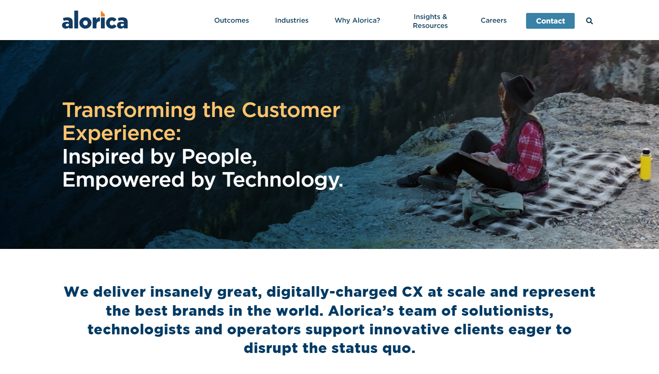
Alorica - Website Redesign & Sitefinity Cloud Implementation

